Slide 1
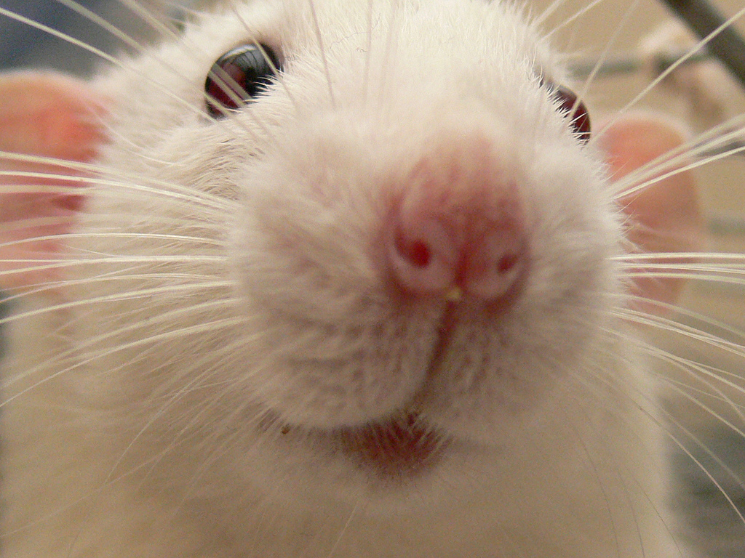
Will taking Strattera Make Me a Better Scientist?
Background
Set-up
Results
A study in rats

Slide 2
Drugs are good ☺
Overview
Aim 1
Overview
Aim 2
Aim 1
Aim 2
Set-up
Overview
Question
Overview
Background
Question
Results
Background
Background
Background
Background
Question
Aim 1
Aim 2
Aim 2
Aim 3
  "Once-daily administration of atomoxetine is an effective treatment for children and adolescents with ADHD.” –Michelson et al., 2002
Notes:
If you have been diagnosed with ADHD, drugs have shown positive effects for your quality of life.

Slide 3
Drugs are good ☺
Overview
Aim 1
Overview
Aim 2
Aim 1
Aim 2
Set-up
Overview
Question
Overview
Background
Question
Results
Background
Background
Background
Background
Question
Aim 1
Aim 2
Aim 2
Aim 3
  "Once-daily administration of atomoxetine is an effective treatment for children and adolescents with ADHD.” –Michelson et al., 2002
  “When administered at the appropriate dose, atomoxetine is generally an effective ADHD treatment.” –Bushe and Savill, 2014
Notes:
If you have been diagnosed with ADHD, drugs have shown positive effects for your quality of life.

Slide 4
Drugs are good ☺
Overview
Aim 1
Overview
Aim 2
Aim 1
Aim 2
Set-up
Overview
Question
Overview
Background
Question
Results
Background
Background
Background
Background
Question
Aim 1
Aim 2
Aim 2
Aim 3
  "Once-daily administration of atomoxetine is an effective treatment for children and adolescents with ADHD.” –Michelson et al., 2002
  “Methylphenidate-induced elevation of norepinephrine neurotransmission enhances sensory processing of behaviorally relevant stimuli.” “Psychostimulant drug actions across the many brain networks that are subject to modulation by locus coeruleus activation and norepinephrine release are capable of improving cognitive function, bettering athletic performance, and enhancing social interactions.” –Navarra and Waterhouse, 2019
  “When administered at the appropriate dose, atomoxetine is generally an effective ADHD treatment.” –Bushe and Savill, 2014

Slide 5
Drugs are good ☺
Overview
Aim 1
Overview
Aim 2
Aim 1
Aim 2
Set-up
Overview
Question
Overview
Background
Question
Results
Background
Background
Background
Background
Question
Aim 1
Aim 2
Aim 2
Aim 3
  "Once-daily administration of atomoxetine is an effective treatment for children and adolescents with ADHD.” –Michelson et al., 2002
  “Methylphenidate-induced elevation of norepinephrine neurotransmission enhances sensory processing of behaviorally relevant stimuli.” “Psychostimulant drug actions across the many brain networks that are subject to modulation by locus coeruleus activation and norepinephrine release are capable of improving cognitive function, bettering athletic performance, and enhancing social interactions.” –Navarra and Waterhouse, 2019
  “Results obtained indicate that the behavioral-calming and cognition-enhancing actions of low-dose psychostimulants involve a selective enhancement in the signal processing abilities of prefrontal cortex neurons.” –Devilbliss and Berridge, 2008
  “When administered at the appropriate dose, atomoxetine is generally an effective ADHD treatment.” –Bushe and Savill, 2014

Slide 6
Drugs are bad ☹
Overview
Aim 1
Overview
Aim 2
Aim 1
Aim 2
Set-up
Overview
Question
Overview
Background
Question
Results
Background
Background
Background
Background
Question
Aim 1
Aim 2
Aim 2
Aim 3
  “We should welcome new methods of improving our brain function and doing it with pills is no more morally objectionable than eating right or getting a good night sleep. Safe and effective cognitive enhancers will benefit both the individual and society. But it would also be foolish to ignore problems that such use of cognitive enhance drug could create or exacerbate.” -Greely et al., 2008
Notes:
However, there can be negative consequences. We recently legalized marijuana but we don’t know how it’s going to affect you long term. The lab also studies alcohol because that’s been legal since before everyone in this room was born but we still don’t know how it interacts with your neurochemicals. Some say that aderall, Ritalin, and strattera fall under the same category.

Slide 7
Drugs are bad ☹
Overview
Aim 1
Overview
Aim 2
Aim 1
Aim 2
Set-up
Overview
Question
Overview
Background
Question
Results
Background
Background
Background
Background
Question
Aim 1
Aim 2
Aim 2
Aim 3
  “We should welcome new methods of improving our brain function and doing it with pills is no more morally objectionable than eating right or getting a good night sleep. Safe and effective cognitive enhancers will benefit both the individual and society. But it would also be foolish to ignore problems that such use of cognitive enhance drug could create or exacerbate.” -Greely et al., 2008
“A meta-analysis showing that atomoxetine is associated with a significantly higher incidence of suicidal ideation than placebo.” –Garnock-Jones and Keating, 2009
Notes:
One being suicide

Slide 8
Drugs are bad ☹
Overview
Aim 1
Overview
Aim 2
Aim 1
Aim 2
Set-up
Overview
Question
Overview
Background
Question
Results
Background
Background
Background
Background
Question
Aim 1
Aim 2
Aim 2
Aim 3
  “We should welcome new methods of improving our brain function and doing it with pills is no more morally objectionable than eating right or getting a good night sleep. Safe and effective cognitive enhancers will benefit both the individual and society. But it would also be foolish to ignore problems that such use of cognitive enhance drug could create or exacerbate.” -Greely et al., 2008
“When used intranasally, methylphenidate has receptor effects similar to those of cocaine…[methylphenidate] has a high potential for abuse … and may lead to severe psychological and physical dependence.” –Morton and Stockton, 2000
“A meta-analysis showing that atomoxetine is associated with a significantly higher incidence of suicidal ideation than placebo.” –Garnock-Jones and Keating, 2009
Notes:
Another being abuse or dependence similar to cocaine addiction. So it really depends on who takes these drugs and how they take them, what the effect will be.

Slide 9
What do we know?
Overview
Aim 1
Overview
Aim 2
Aim 1
Aim 2
Set-up
Overview
Question
Overview
Background
Question
Results
Background
Background
Background
Background
Question
Aim 1
Aim 2
Aim 2
Aim 3
Drugs have different effects depending on the context!!
Notes:
I’m going to focus on off label cognitive enhancing use in this talk.

Slide 10
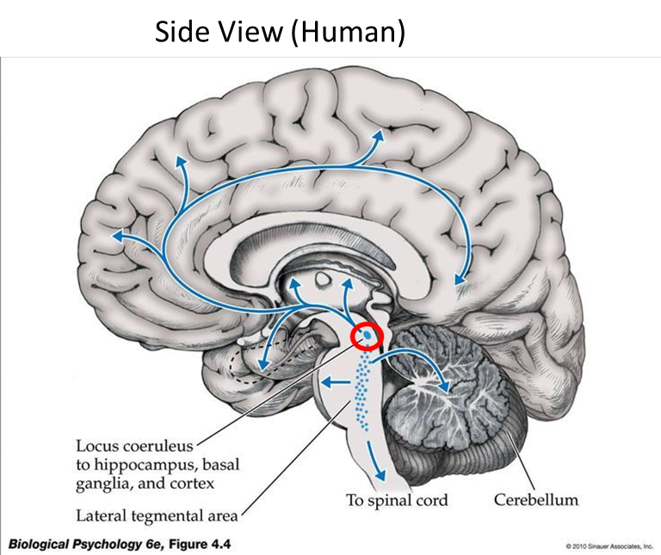

Your Brain
Overview
Aim 1
Overview
Aim 2
Aim 1
Aim 2
Set-up
Overview
Question
Overview
Background
Question
Results
Background
Background
Background
Background
Question
Aim 1
Aim 2
Aim 2
Aim 3
NE
The prefrontal cortex (PFC) is a center for attention and decision making.
Notes:
The PFC has been implicated in executive function such as attention and decision making.
NE has been implicated in many of these activities.

Slide 11
The Locus coeruleus (LC): Brief background
Overview
Aim 1
Overview
Aim 2
Aim 1
Aim 2
Set-up
Overview
Question
Overview
Background
Question
Results
Background
Background
Background
Background
Question
Aim 1
Aim 2
Aim 2
Aim 3
NE
The locus coeruleus is the main source of norepinephrine (NE).
Notes:
Here the LC is shown in a human brain. It projects throughout the entire brain as the main source of norepinephrine.
(Blue spot because melanin in NE cells scatters light in an unstained brain in a way that looks blue.)

Slide 12
The Locus coeruleus (LC): Brief background
Overview
Aim 1
Overview
Aim 2
Aim 1
Aim 2
Set-up
Overview
Question
Overview
Background
Question
Results
Background
Background
Background
Background
Question
Aim 1
Aim 2
Aim 2
Aim 3
NE
The LC projects to the PFC.
Notes:
Projects all around the brain but the circuit I mainly focus on is the LC-PFC circuit highlighted in red.
Potential to regulate attention and other behaviors.
Most of the experiments I’ll go over today are regarding attention

Slide 13
What do we know?
Overview
Aim 1
Overview
Aim 2
Aim 1
Aim 2
Set-up
Overview
Question
Overview
Background
Question
Results
Background
Background
Background
Background
Question
Aim 1
Aim 2
Aim 2
Aim 3
The LC supplies NE to the PFC!!

Slide 14
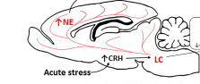

The Locus coeruleus in rats
Overview
Aim 1
Overview
Aim 2
Aim 1
Aim 2
Set-up
Overview
Question
Overview
Background
Question
Results
Background
Background
Background
Background
Question
Aim 1
Aim 2
Aim 2
Aim 3
Rat Sagittal View
Borodovitsyna et al. 2018
Notes:
And it’s in a similar location and function in the rat brain as well.

Slide 15

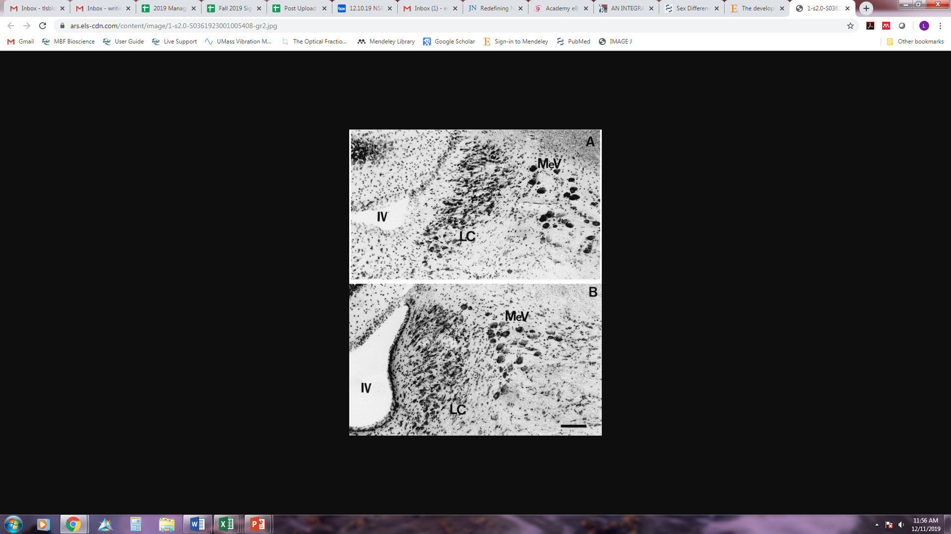
Sex differences in the rat LC
Overview
Aim 1
Overview
Aim 2
Aim 1
Aim 2
Set-up
Overview
Question
Overview
Background
Question
Results
Background
Background
Background
Background
Question
Aim 1
Aim 2
Aim 2
Aim 3
Size
Males
Females
Pinos et al. 2001
Notes:
Why would we think that there might be sexual differences in the noradrenergic regulation of attention? Well we know that the LC is the main source of NE to the cortex including the prefrontal cortex where attention is mainly regulated. We also know that there are sex differences in the LC itself! There are more cells in the female LC.

Slide 16
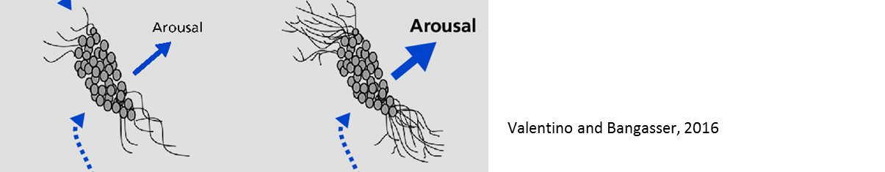

Sex differences in the rat LC
Overview
Aim 1
Overview
Aim 2
Aim 1
Aim 2
Set-up
Overview
Question
Overview
Background
Question
Results
Background
Background
Background
Background
Question
Aim 1
Aim 2
Aim 2
Aim 3
Dendritic arborization
Extent unknown
Size
Males
Females
Pinos et al. 2001
Males
Females
Notes:
Female LC’s also have more complex dendritic arborization, so they have increased sensitivity to LC inputs than male LC’s.

Slide 17
What do we know?
Overview
Aim 1
Overview
Aim 2
Aim 1
Aim 2
Set-up
Overview
Question
Overview
Background
Question
Results
Background
Background
Background
Background
Question
Aim 1
Aim 2
Aim 2
Aim 3
The LC is sexually differentiated!!
Notes:
This is really exciting because ADHD is diagnosed more frequently in males than in females, so if it is regulated by NE, that sex difference could be related to the sex difference in the LC.
So because of the similarities across humans and Long-Evans rats, I’ve been studying sex differences in attention in Long-Evans rats and how it is regulated by NE.

Slide 18

Atomoxetine (ATM)
Background
Set-up
Results
Straterra, also known as atomoxetine, is a norepinephrine reuptake inhibitor
NE
LC axon terminal
NE
LC axon terminal
NE
NE
NE
NE
NE
NE
NE
NE
NE
NE
NE
NE
NE
NE
NE
NE
NE
NE
PFC cell
PFC cell + ATM

Slide 19
What do we know?
Overview
Aim 1
Overview
Aim 2
Aim 1
Aim 2
Set-up
Overview
Question
Overview
Background
Question
Results
Background
Background
Background
Background
Question
Aim 1
Aim 2
Aim 2
Aim 3
Attention treatments often target NE!!
Notes:
And if you’ll notice they are trying to increase the amount of NE readily available.

Slide 20
Overview
Aim 1
Background
Set-up
Results
Background
Aim 2
Yerkes-Dodson Law
Performance
Arousal
Yerkes and Dodson, Hebbian - Diamond DM, et al. (2007)
Notes:
Common hypothesis in psychology
Think of performance as completing an exam or getting work done in the lab etc.
Arousal can be your internal response to external stimulus.

Slide 21
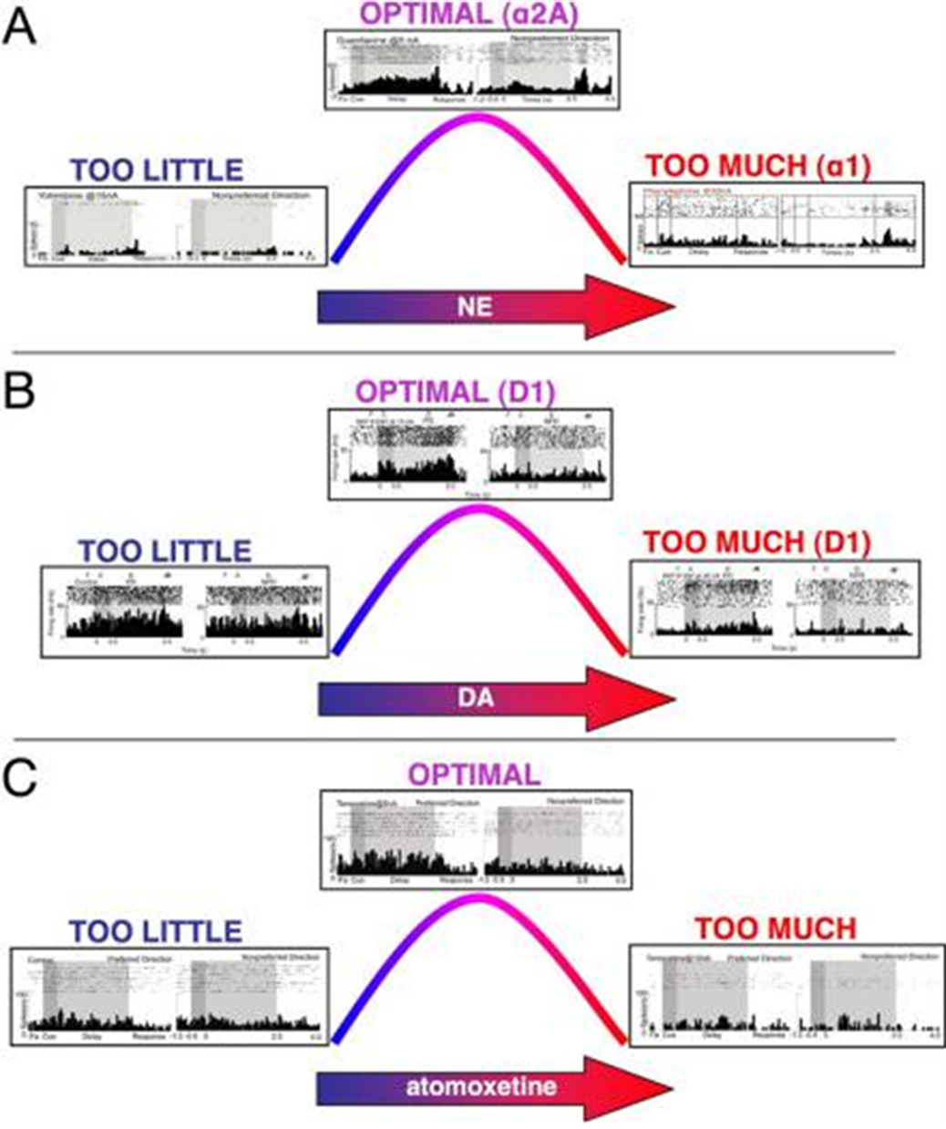
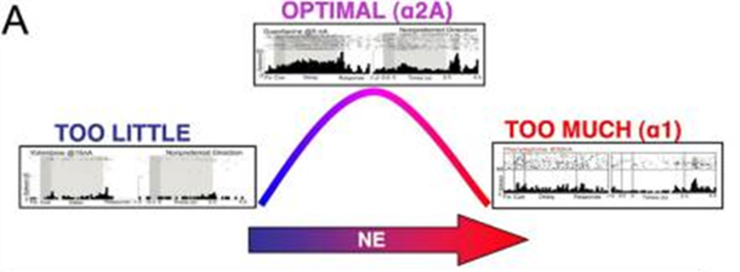
Yerkes-Dodson Law
Overview
Aim 1
Overview
Aim 2
Aim 1
Aim 2
Set-up
Overview
Question
Overview
Background
Question
Results
Background
Background
Background
Background
Question
Aim 1
Aim 2
Aim 2
Aim 3
Arnsten (2011)
Notes:
Similar trend in NE, (NE reuptake inhibitor) ATM, arousal, and in attention behavior. These are extracellular recordings from dorsolateral PFC in monkeys performing a working memory task. When the monkey performed optimally, they took these recordings which had optimal activity correlating with the behavior.

Slide 22
What do we know?
Overview
Aim 1
Overview
Aim 2
Aim 1
Aim 2
Set-up
Overview
Question
Overview
Background
Question
Results
Background
Background
Background
Background
Question
Aim 1
Aim 2
Aim 2
Aim 3
There’s an optimal NE + DA level!!

Slide 23
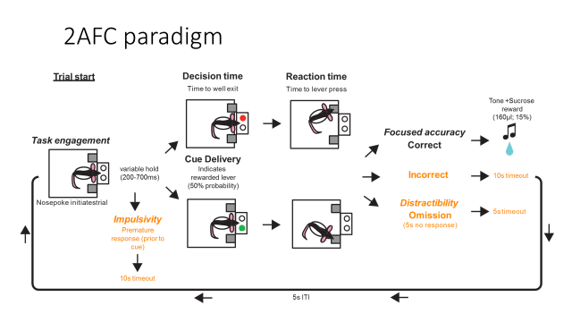

Aim 1
Set-up
Background
Question
Overview
Results
Background
Aim 2
Aim 3
Notes:
How do I measure attention in rats? I trained them in a 2afc paradigm.

Slide 24


Aim 1
Set-up
Background
Question
Overview
Results
Background
Aim 2
Aim 3

Slide 25
Aim 1
Set-up
Background
Question
Overview
Results
Background
Aim 2
Aim 3

Slide 26



Aim 1
Set-up
Background
Question
Overview
Results
Background
Aim 2
Aim 3

Slide 27
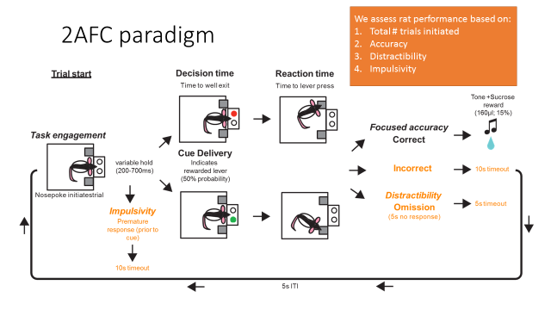
Aim 1
Set-up
Background
Question
Overview
Results
Background
Aim 2
Aim 3

Slide 28
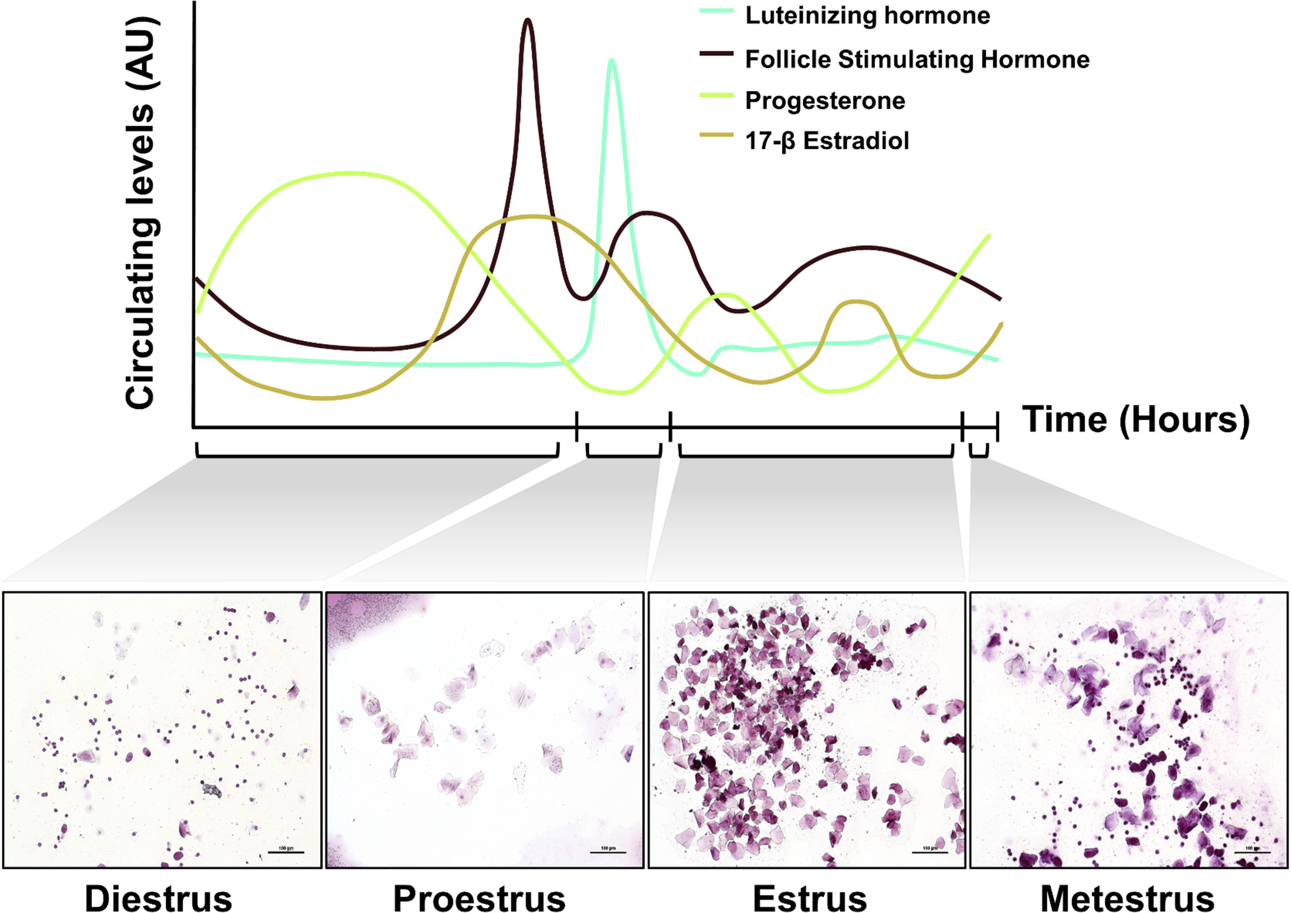
Lavage
Background
Set-up
Results
Thanks Sarah!
Wallace et al. 2018
Notes:
We have not found any sex differences although it might be due to food restriction.

Slide 29
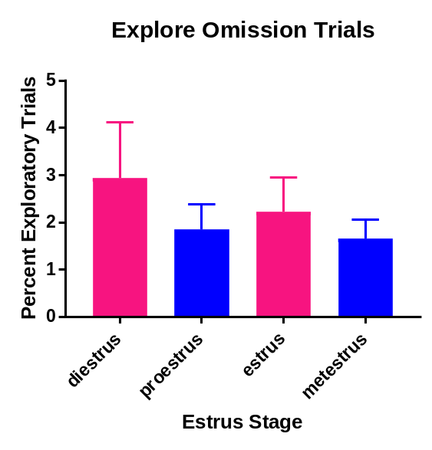
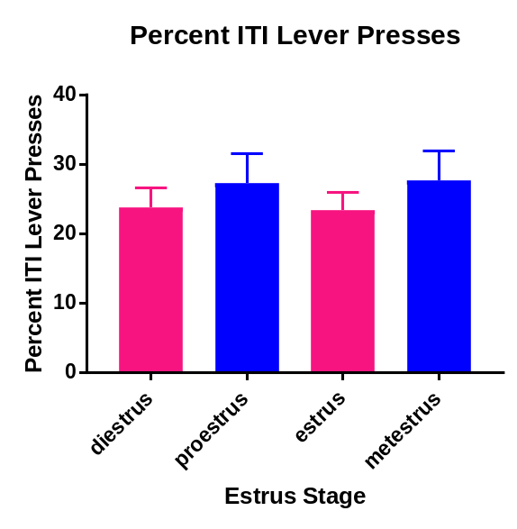
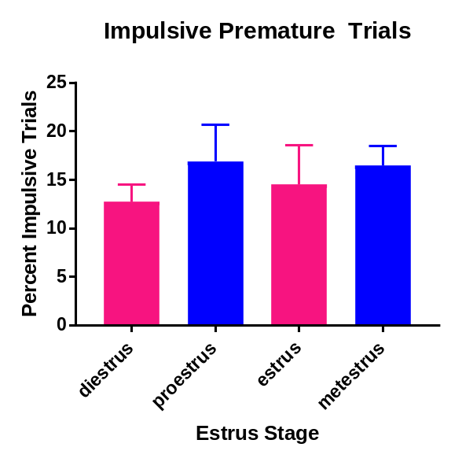
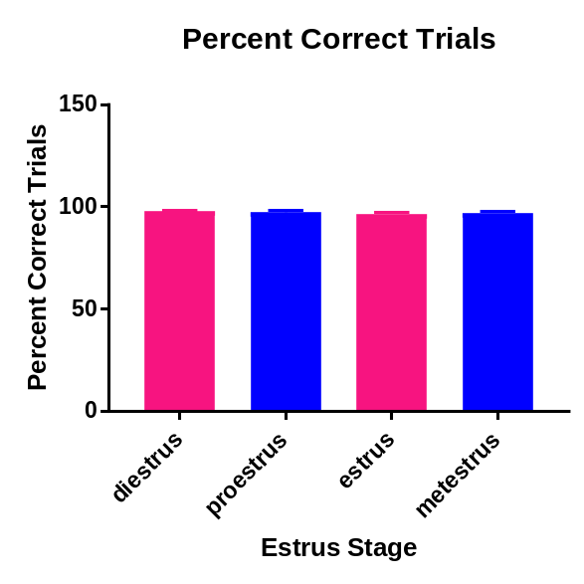
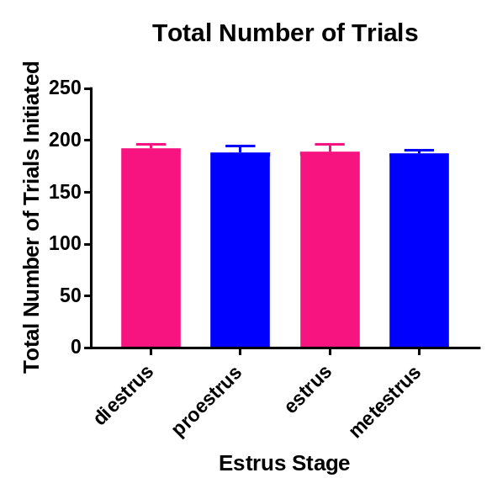
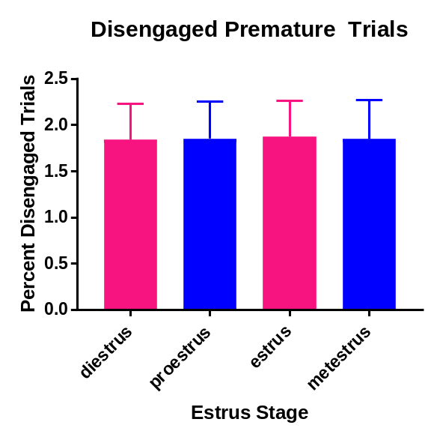
Lavage Data
Background
Set-up
Results

Slide 30
What do we know?
Overview
Aim 1
Overview
Aim 2
Aim 1
Aim 2
Set-up
Overview
Question
Overview
Background
Question
Results
Background
Background
Background
Background
Question
Aim 1
Aim 2
Aim 2
Aim 3
Female hormonal cycles do not affect cognitive behavior!!

Slide 31

Timeline
Overview
Aim 1
Overview
Aim 2
Background
Question
Overview
Aim 1
Aim 2
Aim 1
Aim 1
Aim 1
Aim 2
Aim 3
Set-up
Overview
Overview
Overview
Question
Overview
Question
Question
Background
Question
Results
Background
Background
Background
Background
Background
Background
Question
Aim 1
Aim 2
Aim 2
Aim 2
Aim 2
Aim 3
Aim 3
Aim 3
Injections/ behavioral testing
2AFC training
Rats arrive
End of Testing
Weekly
4 weeks
5 weeks
4 weeks
Notes:
Behavior in cohorts but recordings one by one. Timing varies by individual.

Slide 32
Timeline
Overview
Aim 1
Overview
Aim 2
Background
Question
Overview
Aim 1
Aim 2
Aim 1
Aim 1
Aim 1
Aim 2
Aim 3
Set-up
Overview
Overview
Overview
Question
Overview
Question
Question
Background
Question
Results
Background
Background
Background
Background
Background
Background
Question
Aim 1
Aim 2
Aim 2
Aim 2
Aim 2
Aim 3
Aim 3
Aim 3
Injections/ behavioral testing
2AFC training
Rats arrive
End of Testing
Weekly
4 weeks
5 weeks
4 weeks
Lavage and rats brought downstairs
Rats brought upstairs
ATM injection
End of Testing
2AFC testing
Daily
30 minutes
20-30 minutes
40 minutes
Notes:
So, what did I find?

Slide 33
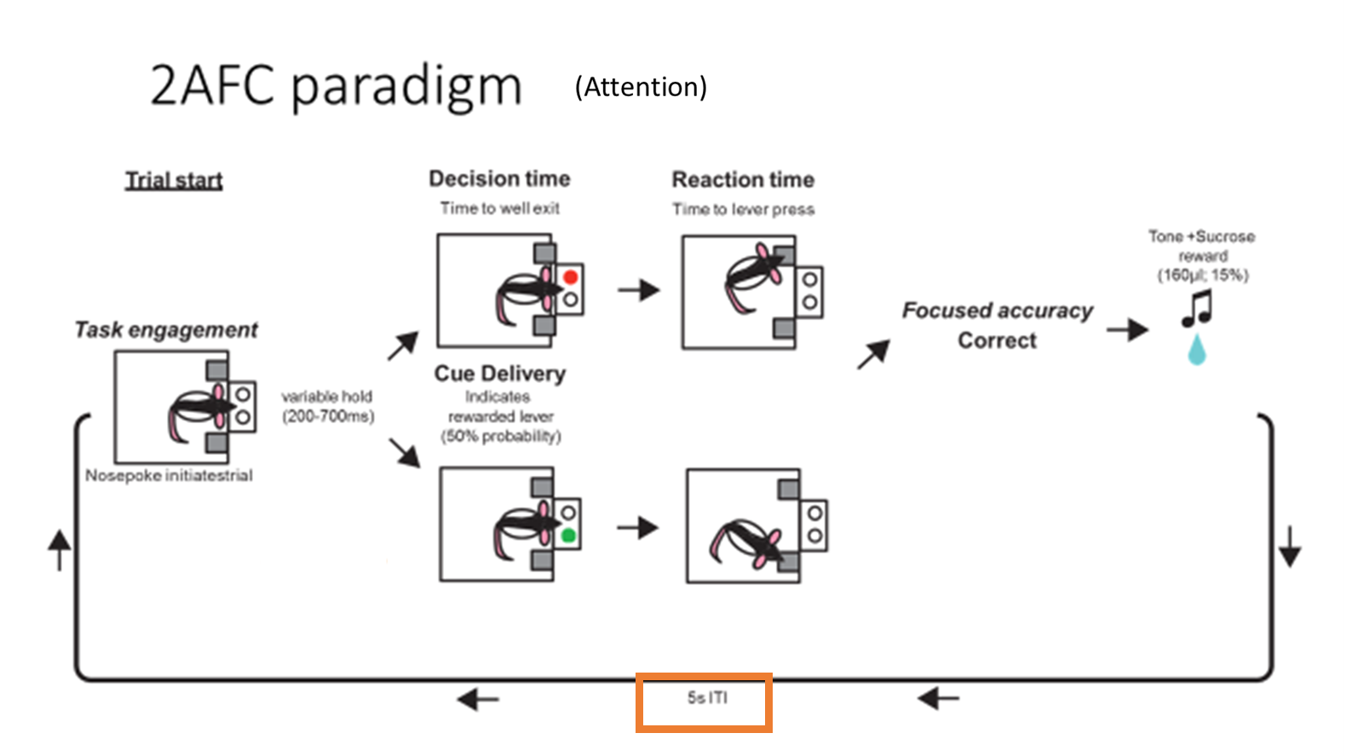
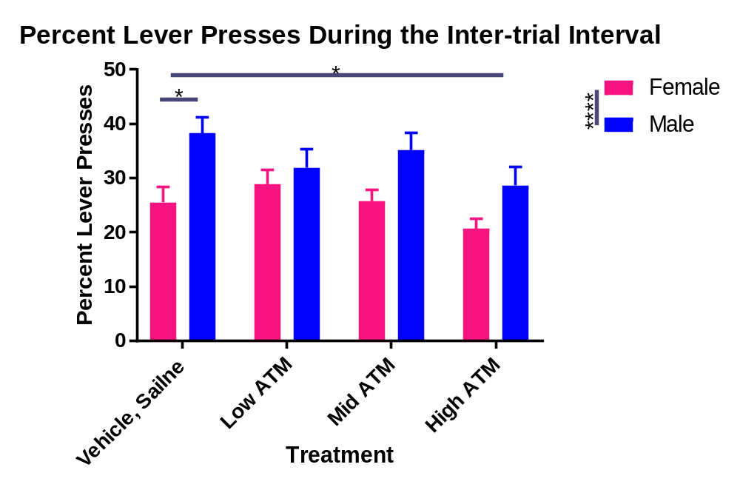
Males are Impulsive
Background
Set-up
Results
Notes:
My rats decreased their inter-trial interval lever presses. This indicates a decrease in impulsive behavior. This is probably where most of the hype for these drugs comes from.

Slide 34
ATM Decreases Impulsivity
Background
Set-up
Results
Notes:
My rats decreased their inter-trial interval lever presses. This indicates a decrease in impulsive behavior. This is probably where most of the hype for these drugs comes from.

Slide 35
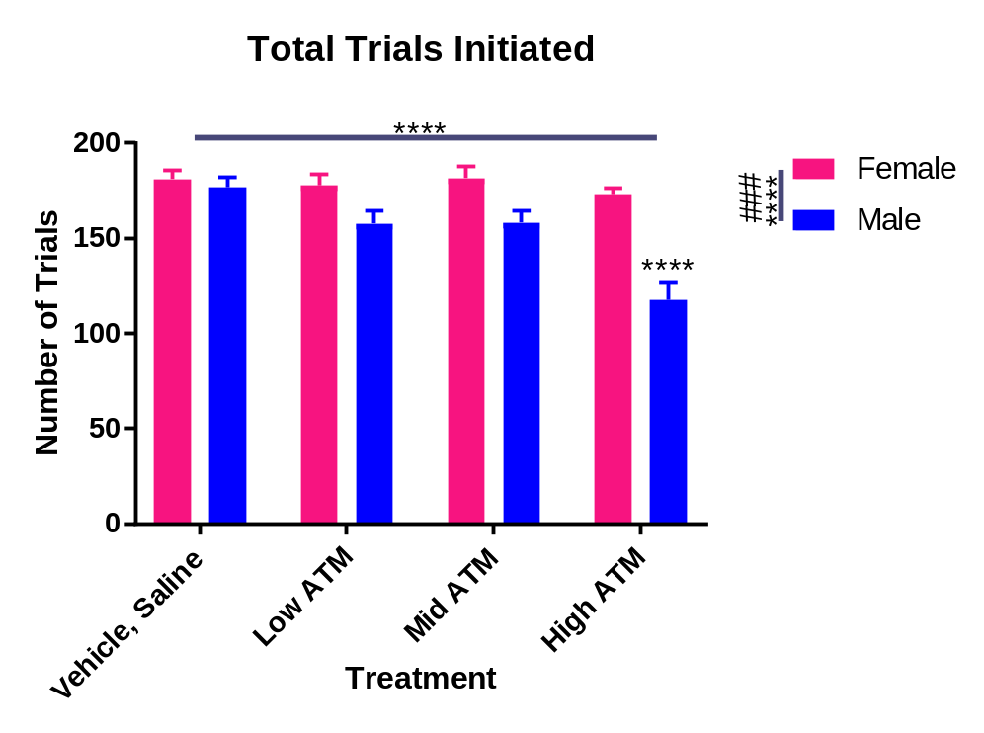
ATM Decreases Task Engagement in Males
Background
Set-up
Results
Sex effect: ATM affects males more than females.
Dose effect: The high dose of ATM has the greatest effect.
Interaction: ATM has a negative affect on males taking the high dose.
Notes:
Basically all driven by the high dose in males. (cocaine)
Overview: In males but not females, ATM decreases task engagement,

Slide 36
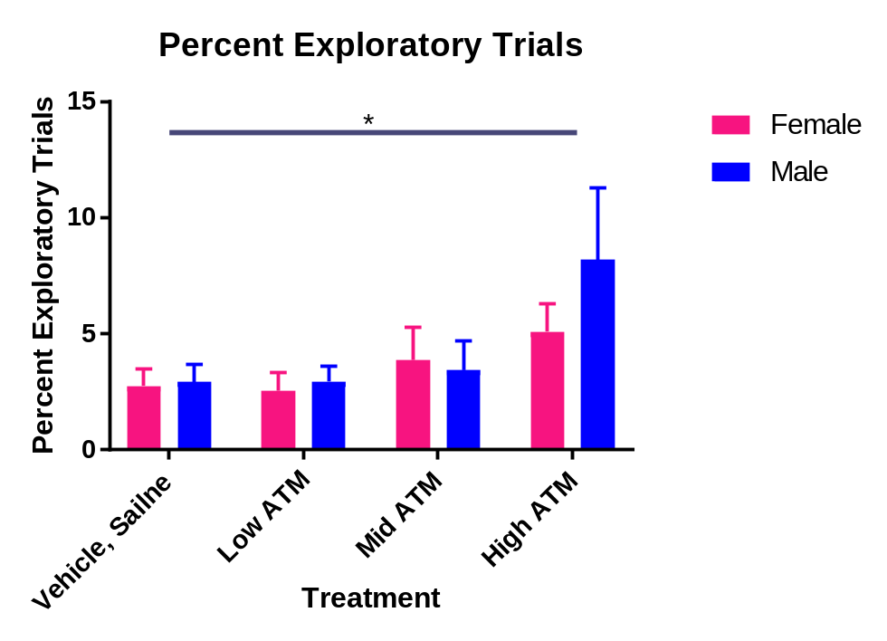
ATM Increases Distractibility
Background
Set-up
Results
Dose effect: High concentrations of ATM increase distracted trials.
Notes:
At physiologically relevant doses, it’s not having any significant effect and at high doses it is detrimental, especially for males.
increases distractibility.

Slide 37
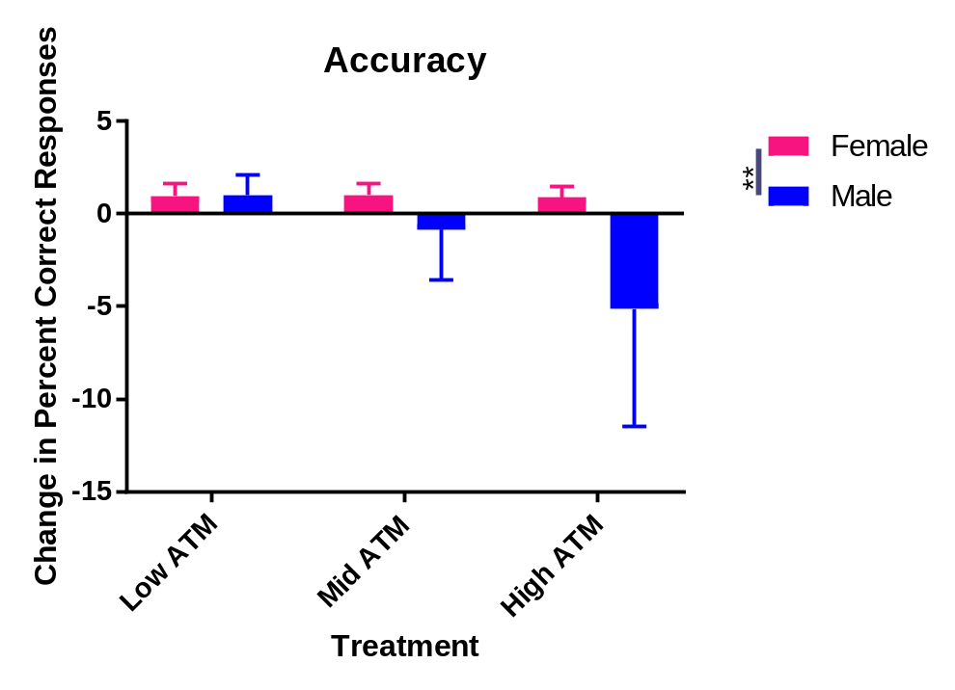
ATM Decreases Accuracy in Males
Background
Set-up
Results
Sex effect: ATM negatively affects males.
Notes:
decreases accuracy relative to vehicle performance.
So we understand why it may seem like they are more focused, but in reality they’re not performing better.
At physiologically relevant doses, it’s not having any significant effect and at high doses it is detrimental, especially for males.

Slide 38
What do we know?
Overview
Aim 1
Overview
Aim 2
Aim 1
Aim 2
Set-up
Overview
Question
Overview
Background
Question
Results
Background
Background
Background
Background
Question
Aim 1
Aim 2
Aim 2
Aim 3
ATM decreases cognitive performance, especially in males!!

Slide 39
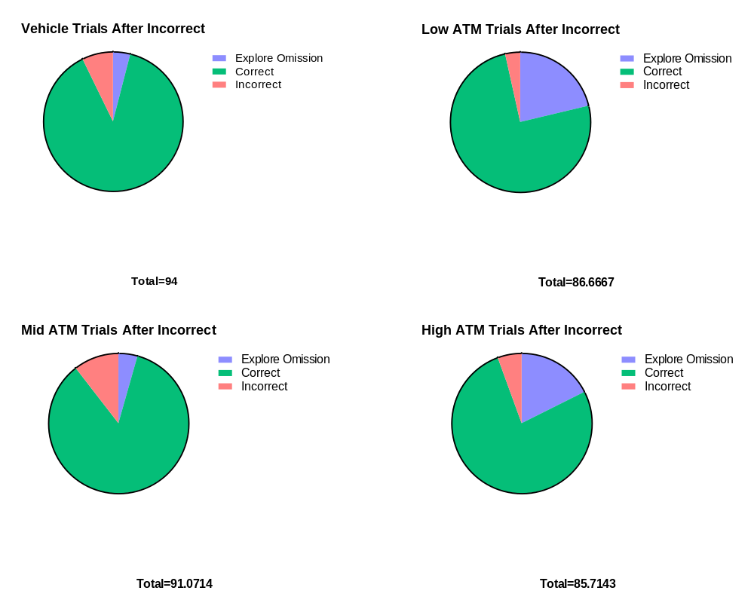
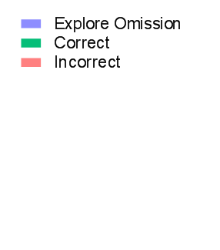
Background
Set-up
Results
Mainly Correct Responses After Incorrect Trials
Vehicle
Low ATM
Mid ATM
High ATM
Male
Female
Notes:
Males generally go back to performing well after an error.

Slide 40
Background
Set-up
Results
Males Decrease Performance with ATM
Vehicle
Low ATM
Mid ATM
High ATM
Male
Female
Notes:
Interestingly, when they get ATM the percentage of correct trials decreases. Also interesting is how the distribution changes across doses. They become more exploratory at the low and high doses but more likely to complete two incorrect trials in a row under the middle dose of ATM.

Slide 41
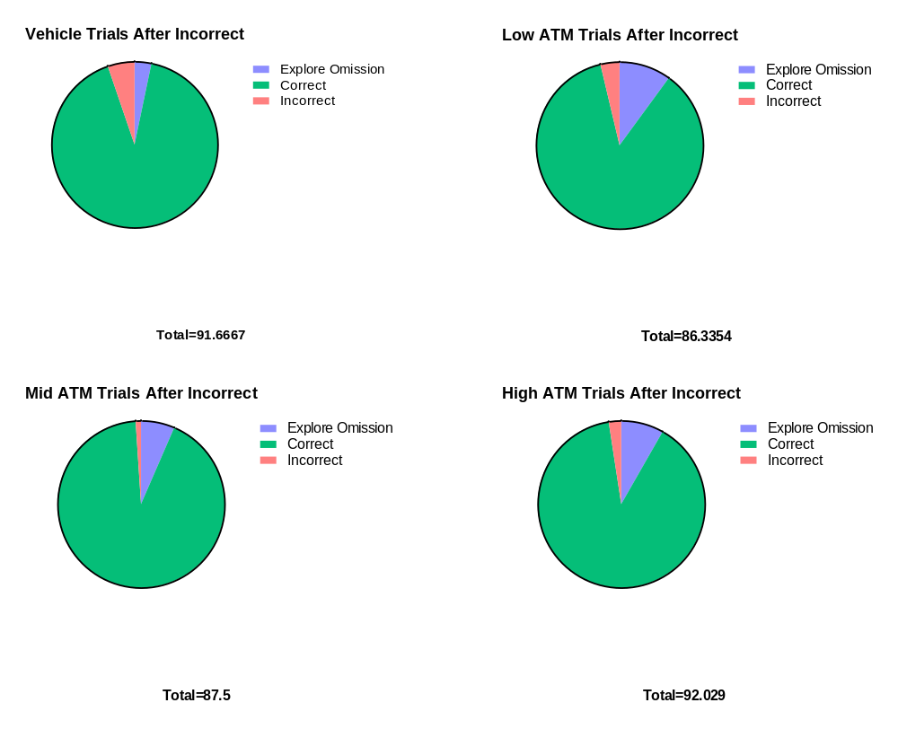
Background
Set-up
Results
Mainly Correct Responses After Incorrect Trials
Vehicle
Low ATM
Mid ATM
High ATM
Male
Female
Notes:
Females also mainly perform well after they got a trial wrong.

Slide 42
Background
Set-up
Results
Females Shift to Exploratory Trials with ATM
Vehicle
Low ATM
Mid ATM
High ATM
Male
Female
Notes:
Females don’t decrease their corrects with ATM like males do. Females increase explore omissions and decrease incorrects after an incorrect at all doses of ATM.

Slide 43
What do we know?
Overview
Aim 1
Overview
Aim 2
Aim 1
Aim 2
Set-up
Overview
Question
Overview
Background
Question
Results
Background
Background
Background
Background
Question
Aim 1
Aim 2
Aim 2
Aim 3
ATM decreases post-error performance in males but not females!!

Slide 44
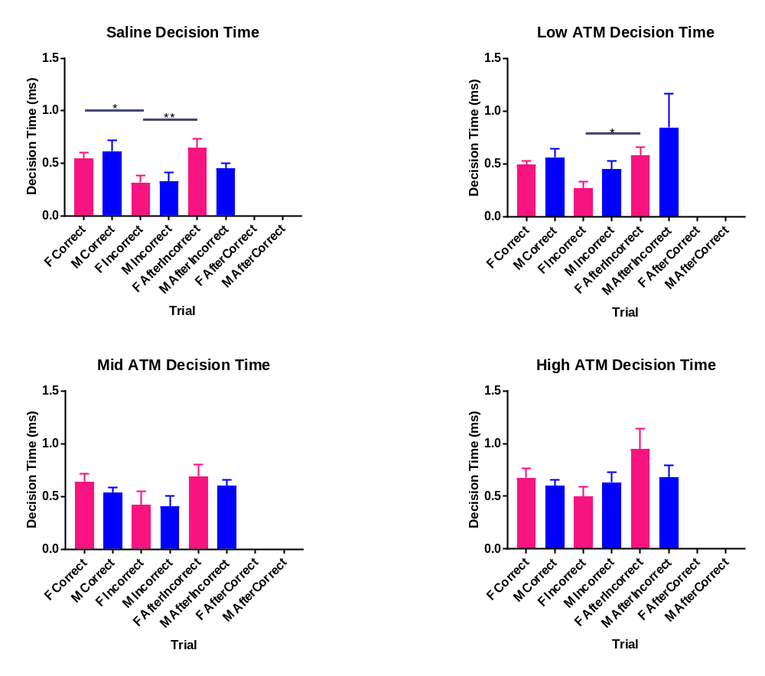
Background
Set-up
Results
Incorrect Trials are Rushed Decisions
Trial
Notes:
It takes both males and females longer to make a correct decision than an incorrect decision. For females it’s significant but males are very close to significance too.

Slide 45
Background
Set-up
Results
Females Show Post-error Slowing
Notes:
Post-error slowing is a well characterized phenomenon. After they make an error, females will take longer to make sure that it doesn’t happen again. Males do a little but not significantly and it shows in their behavior.

Slide 46
Background
Set-up
Results
Females Take Longer to Make Incorrect Decisions with ATM
Vehicle
Low ATM
Mid ATM
High ATM
Notes:
Females generally learn from their mistakes and think longer on the next trial to make fewer mistakes. Males don’t do that and females under ATM stop doing that as effectively.

Slide 47
What do we know?
Overview
Aim 1
Overview
Aim 2
Aim 1
Aim 2
Set-up
Overview
Question
Overview
Background
Question
Results
Background
Background
Background
Background
Question
Aim 1
Aim 2
Aim 2
Aim 3
ATM increases decision time in females!!

Slide 48
Summary and Future Directions
Background
Set-up
Results
These rats become less impulsive after administration of Strattera.
All other tested behaviors worsened with high doses of these drugs.
Males are more influenced by Strattera than females.
Does Ritalin show similar sex differences? (Spoiler alert: No!)
What is the underlying neural circuit?
(what receptors on what cells in what part of the brain influencing what activity)
Will combining DREADDs with ATM return performance to baseline?
Are other behaviors affected by these manipulations?
Are there sex differences in all of the above?
Notes:
I’ve already done a lot of these experiments but haven’t analyzed the data yet.

Slide 49


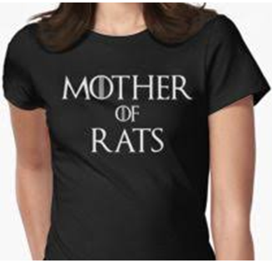




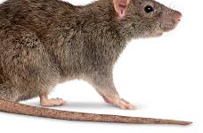






Overview
Aim 1
Overview
Aim 2
Background
Question
Overview
Aim 1
Aim 2
Aim 1
Aim 1
Aim 1
Aim 1
Aim 1
Aim 1
Aim 2
Aim 3
Set-up
Overview
Overview
Overview
Overview
Overview
Overview
Question
Overview
Question
Question
Question
Question
Question
Background
Question
Results
Background
Background
Background
Background
Background
Background
Background
Background
Background
Question
Aim 1
Aim 2
Aim 2
Aim 2
Aim 2
Aim 2
Aim 2
Aim 2
Aim 3
Aim 3
Aim 3
Aim 3
Aim 3
Aim 3
Thank you!
Current helping hands
Onto better things
Elena Vazey
Joe Bergan
Paul Katz
Ellen Rodberg
Kara Conlan
Cam Donahue Ben Earle Judy Luu
Michael Kelberman Josh D’Antonio
Notes:
Kara and Ben have been incredibly helpful in collecting and analyzing the data presented today.

